Slide 1
Kinematics Terms and Questions
What measures must be known to…
Make a moving object catch a falling object?
Program a yellow light for safe use?

Slide 2
What should my notebook look like?
Notebooks are a waste, unless YOU can benefit from using them.
The most useful notebook is flexible (in terms of its capacity to organize your work).
Yours should have sections for:
Vocabulary
Example problems
Important Questions (you ask, I ask, or classmates ask)
Lab Reports
Returned:
HW
Labs
quizzes

Slide 3
Lets ask some questions about…
…KINEMATICS

Slide 4
(Your) Kinematics Questions (so far…)
How fast…?
How far…?
How long…?
Where…?
When…?

Slide 5
(Your) Kinematics Questions (after editing)
- - when?
- - where is (was) object?
- - how long does (did) motion take?
- - how far does object move?
- - how far (and which way) is
object moved from start?
- - how fast is object moving?
- - how fast & which way is it
moving?

Slide 6
Measurement Names
-time -
-duration -
-position -
-distance -
-displacement -
-speed -
-velocity -
-Which of these terms relates two other terms?

Slide 7
Assignment
Quest Kinematics I #1-7

Slide 8
Time vs Duration
What is the difference?
What is the same?
Which one must be computed if you use a traditional clock? How do you perform that computation

Slide 9
Distance vs Displacement
What is the difference?
What is the same?
Which measurement matters to a football coach?
Which one affects how tired a running back would be at the end of a play?
Which one is 1600m when the “mile” is run at a track meet?

Slide 10
Distance and Displacement
During a “suicide” athletes start at one end of the gym, sprint to the foul line (15 feet), then back to the end-line, then sprint to the mid-court line (42 feet), then back to the initial end-line, then sprint to the other foul line, then back to the initial end-line, then sprint to the opposite end line. Determine the distance and displacement for each athlete. A diagram of the court would be useful!

Slide 11
Speed and Velocity
What is the difference?
What is the same?
What formulas are used?
What do you call the value if the speed of the object isn’t constant?

Slide 12
Average vs Instantaneous
speed velocity
formula
meaning
use

Slide 13
Avg. Speed and Velocity
During a “suicide” athletes start at on end of the gym, sprint to the foul line (15 feet), then back to the end-line, then sprint to the mid-court line (42 feet), then back to the initial end-line, then sprint to the other foul line, then back to the initial end-line, then sprint to the opposite end line. This takes the athlete 28 seconds. Would the athlete’s average speed or average velocity be of interest? Compute the measurement that would be useful. A diagram of the court might be useful!

Slide 14
Example
At a CB South track meet, Pat competes in the 1600m (4 laps of the 400m track). Pat completes the first lap of the race in 60.0 seconds, the second lap in 62.0 seconds, the third lap in 73.0 seconds, and the last lap in 65.0 seconds. Compute Pat’s average speed or average velocity (whichever has relevance in this problem).

Slide 15
What is the (average) speed of your jeep?
This is a lab, but not a “…mathematical relationship between…” lab. What kind of report do we want?

Slide 16
What is the mathematical relationship between ________ (__) and _______ (__) for the jeep while it moves at a constant speed?
What are the simplest (most fundamental) two kinematics measurements that will fit this question?

Slide 17
Mathematical Relationship Lab
What is the mathematical relationship between the position (m) and time (s) for the jeep (that moves at a constant speed in the positive direction, beginning at the origin)?
Determine the equation that relates position to time for the jeep (while it is in motion).
Explain what the equation means.
Give a real world example (RWE) that illustrates what you just explained (for the two variables we are focusing on, NOT for some analogous situation.)

Slide 18
Steps to a mathematical relationship lab:
Perform trials, recording data – be sure you know which is dependent and which is independent!
Graph Data (sometimes this is done for you!)
Determine equation.
Explain, illustrate relationship.
Take a PLQ, or write a report.

Slide 19
POD
A toy jeep moves at a steady speed of 0.350m/s. How long will it take this jeep to travel 0.850m?

Slide 20
Position vs Time Graphs (x-t graphs)
x is the vertical axis because…
The rise of the graph is the object’s…
The slope of the graph determines the…
If the graph has a straight, diagonal line, the __________ is constant.
If the graph has a horizontal line, the __________ is constant.
Slope can be positive, negative, constant, increasing (getting steeper) or decreasing (getting less steep)

Slide 21
Warm-up Question
What measurement could be defined as the distance (and direction) from the origin?
QUESTions?

Slide 22
What is the mathematical relationship between…
position (m) and time (s) for the cart on an incline, if it starts from rest at the origin at t=0.0s and rolls down the incline?

Slide 23
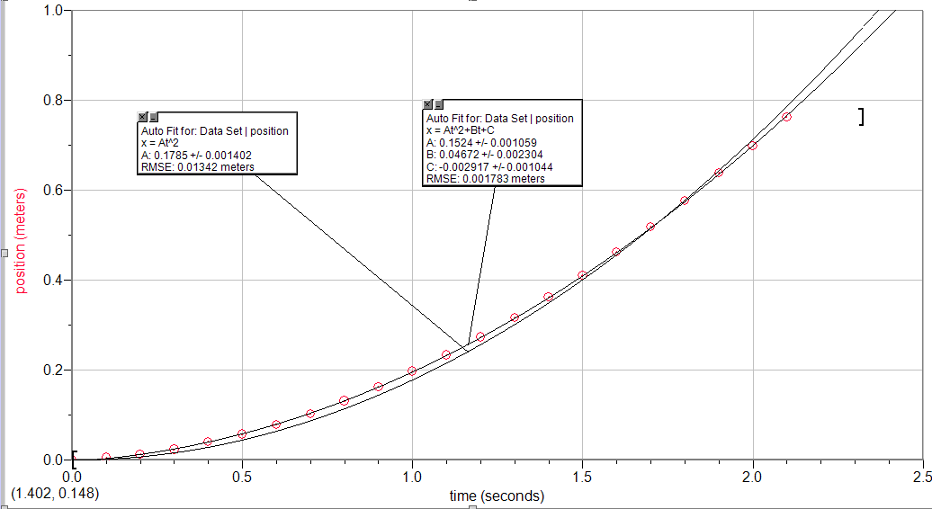
What is the mathematical relationship between the position (m) and time (s) for…

Slide 24
What is the mathematical relationship between the position (m) and time (s) for the cart that starts from rest at the origin and gains speed?
-The (change of) position of the cart is exponentially proportional to (the change of) time (with an exponent of 2), as shown by the equation:
x(t) = 0.1524t² + 0.04627t -0.002917
-This means that the cart will change position four times as much in twice the change in time (if it starts from rest).
-For example, if the cart moved from the origin to position A by time t, then it would move to position 4A by time 2t. (This is because the cart ….)

Slide 25
Symbols - Terms - Questions
- - when?
- - where is (was) object?
- - how long does (did) motion take?
- - how far does object move?
- - how far (and which way) is
object moved from start?
- - how fast is object moving?
- - how fast & which way is it
moving?
- - how quickly does the _______
change?

Slide 26
Terms – Definitions
-time -
-duration -
-position -
-distance -
-displacement -
-speed -
-velocity -
-acceleration -
Which of these terms relates two other terms?

Slide 27
Kinematics Terms Organized by …
time position
duration
distance displacement
speed velocity
acceleration

Slide 28
Terms and Equations
-duration -
-displacement -
-speed (ave) -
-velocity (ave) -
-acceleration (ave)-

Slide 29
POD
A car traveling at 22 m/s slows down to 12m/s. This takes 5.00 seconds. Determine the car’s acceleration.

Slide 30
Do you KNOW the Terms?
What’s happening if an object has:
Constant position?
Constant VELOCITY?
Constant SPEED?
Constant acceleration?
Constant position is the same thing as zero:
Constant velocity is the same thing as zero:

Slide 31
What is the cause?
Is there a cause of
position?
velocity?
acceleration?
If so, what is the cause?

Slide 32
A NET Force
The cause of acceleration
The result of adding all the forces acting on an object
A vector, and the acceleration it causes is in the same direction

